Slide 1
Natural Language Processing
Group 2
Aleix Quirante
Felipe Doria
Marcos Sousa
Sohail Hiraj
Notes:
Title - Sohail
Slide 2 - Felipe
Slide 3 - Aleix
Slide 4 - Felipe
Slide 5 - Felipe
Slide 6 - Marcos
Slide 7 - Aleix
Slide 8 - Marcos
Slide 9 - Marcos
Slide 10 - Felipe (Optional)
Slide 11 - Sohail

Slide 2
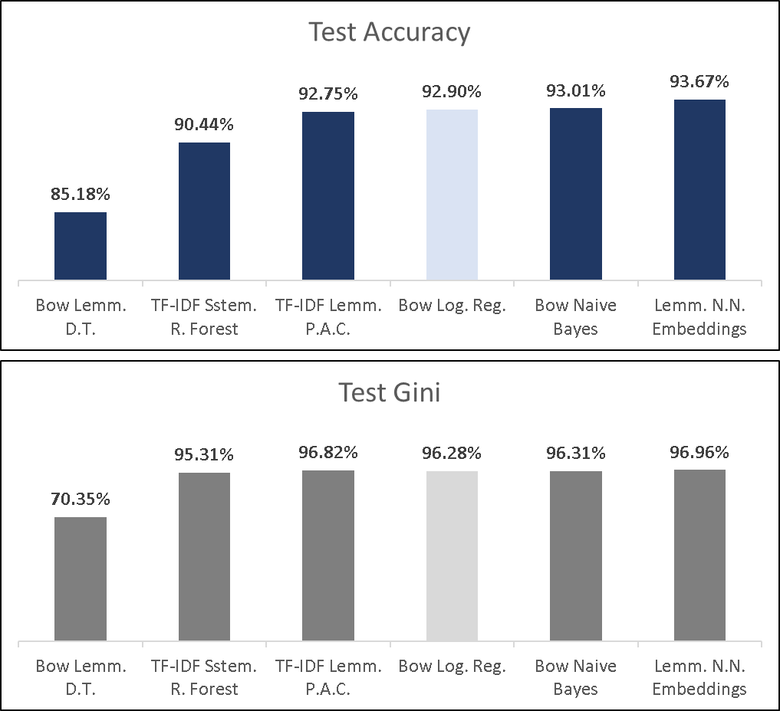
Selected Logistic Regression as the Optimal Model Based on Simplicity
Best Accuracy of ~93% and Gini of 96%
Model used Bow Logistic Regression.
6 model types with similar accuracy and gini
Decision Tree
Random Forest
Logistic Regression
Naive Bayes
Passive Aggressive Classifier
N.N-based Embeddings.
We opted for the simplest model.

Slide 3
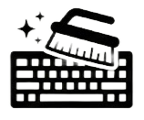
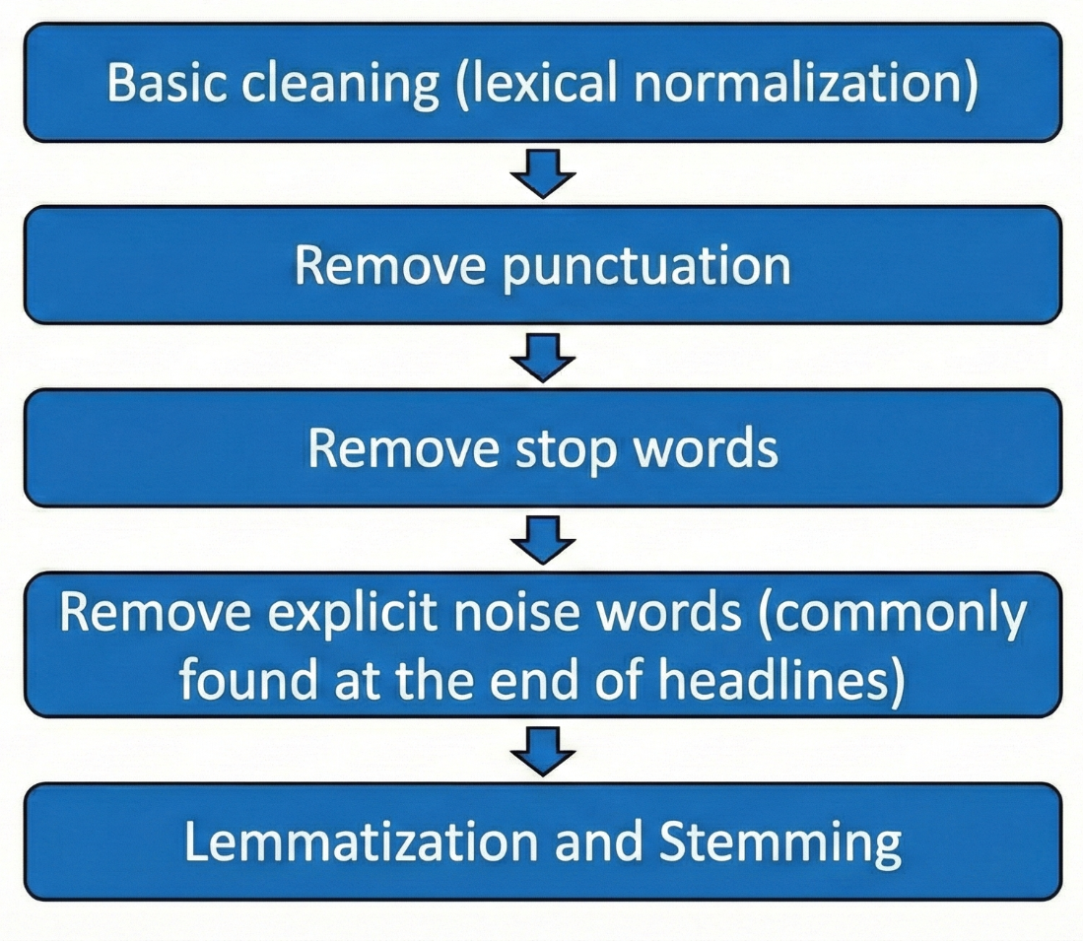


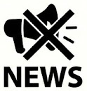

Let’s preprocessing the data
Notes:
Basic Cleaning (lexical normalization)
Remove punctuation
Remove stop words
Remove explicit noise words normally found at the end of the news headline
Stemming and Lemmatization

Slide 4
BoW + Preprocessing outperform Complex Feature Engineering
Datasets:
Preprocessed text (Bow Logistic Regression - Acc: 92.9 %, Gini: 96.28 %).
Preprocessed text + manually filtered words.
Preprocessed text + Snow-stemmed.
Preprocessed text + Porter-stemmed.
Preprocessed text + lemmatized (N.N. Embeddings - Acc: 93.67 %, Gini: 96.96 %).
Vectorization:
BOW.
TF-ID.
Models:
Random Forest
Decision Tree, Logistic Regression, and Naïve Bayes
Passive Aggressive Classifier
N.N-based Embeddings
Notes:
Random Forest - It generally gives us good results.
Decision Tree, Logistic Regression, and Naïve Bayes - Their simplicity in explaining their results.
Passive Aggressive Classifier - Mainly used for large-scale text classification.
N.N-based Embeddings - Good for a large enough dataset (+ 10k texts).

Slide 5
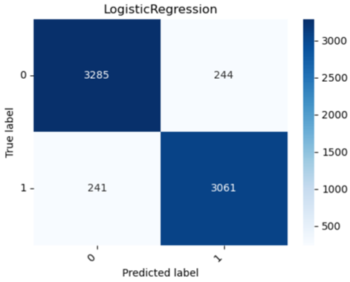
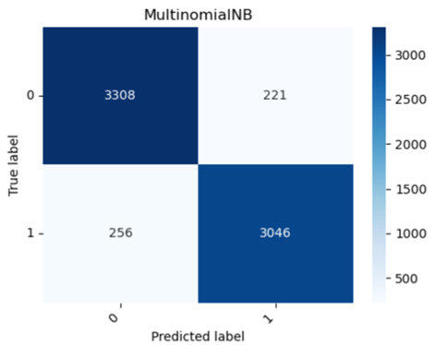
Bow Logistic Regression model slightly performs better than the others with a higher recall for class 1
Logistic Regression
Naive Bayes

Slide 6
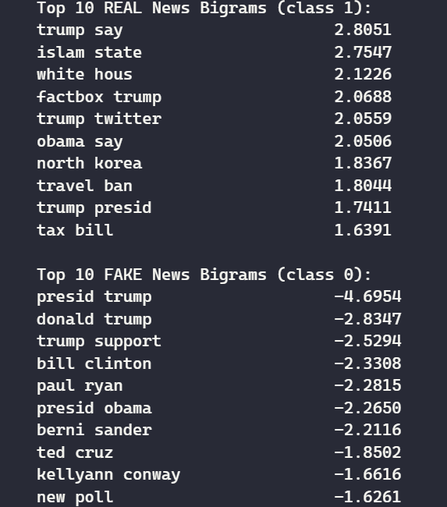
N-Grams
Real news bigrams reflect institutional reporting and policy context
Fake news bigrams are dominated by personality-centric and speculative framing
The contrast highlights a stylistic distinction rather than factual verification
Notes:
Real news emphasize reported speech (“trump say”, “obama say”), government actions (“travel ban”, “tax bill”), and geopolitical framing (“north korea”, “islam state”).
Fake news - focus on named political figures (“donald trump”, “bill clinton”, “berni sander”) and polling or opinion cues (“new poll”, “trump support”).
real news prioritizes actions and policies, while fake news emphasizes individuals and narratives.

Slide 7
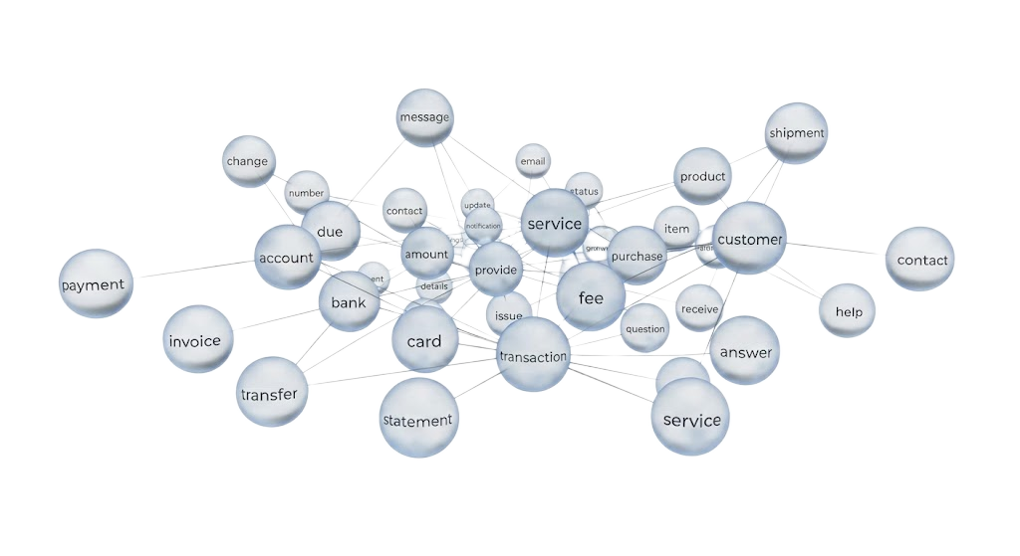
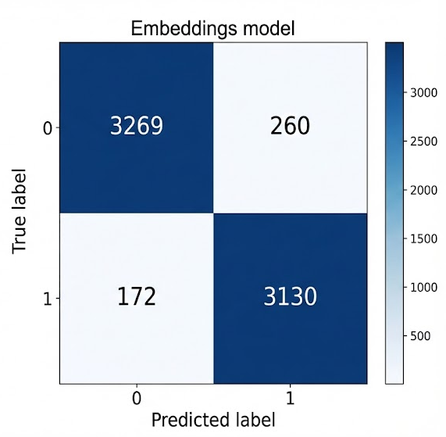
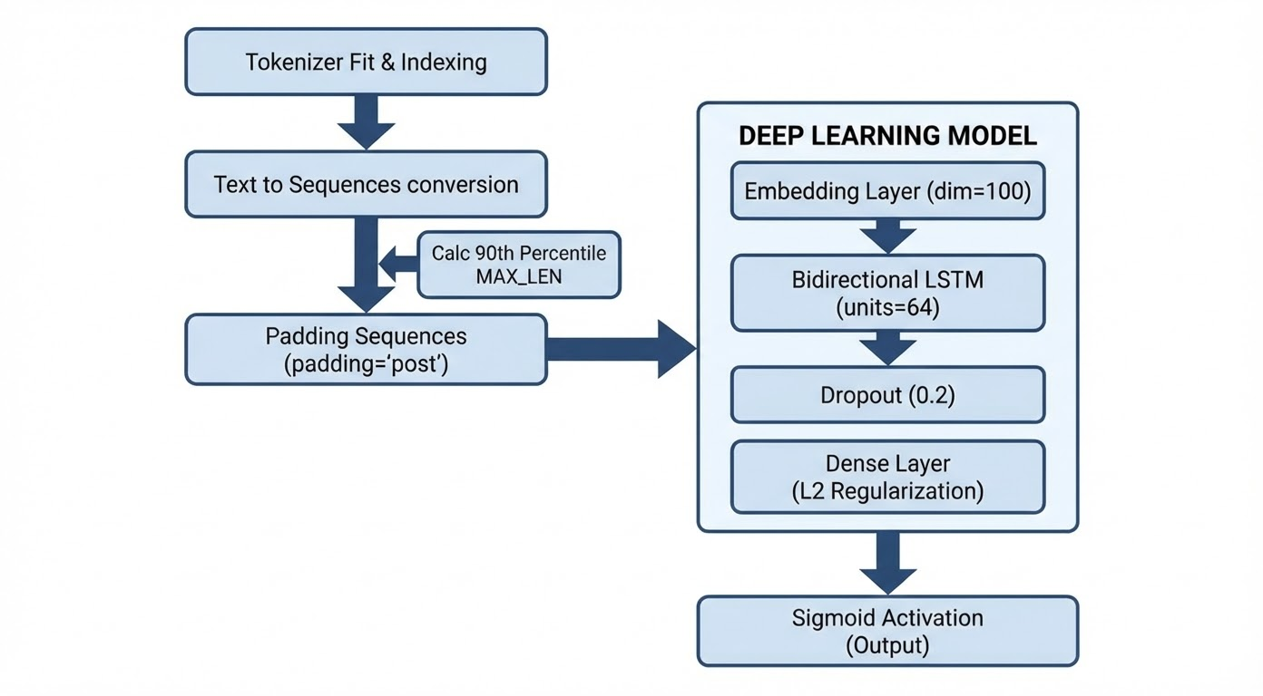
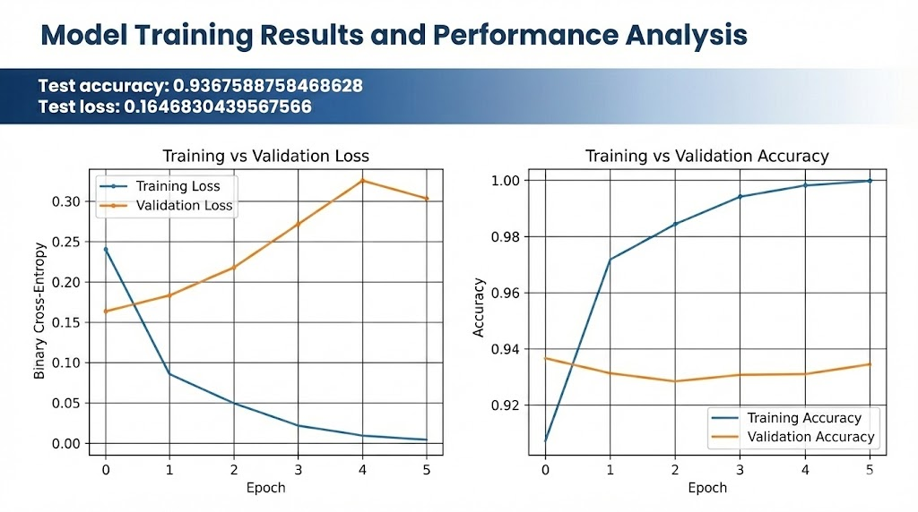
Results
Embedding

Slide 8
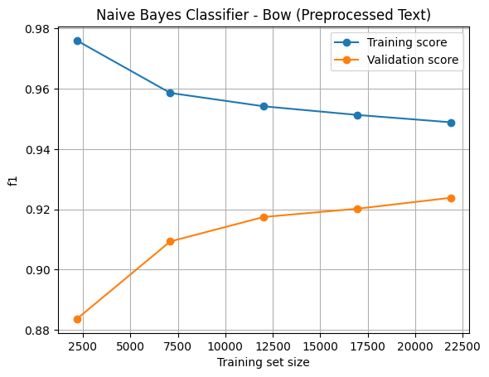
Plotting
Validation performance improves steadily with more data
Training performance decreases slightly as the model generalizes
The gap between training and validation narrows
Notes:
As we increase the training set size, validation F1 consistently improves, showing that the model benefits from more data rather than overfitting early
Training performance decreases slightly as more data is added, which is expected and indicates the model is moving away from memorization toward generalization.
The shrinking gap between training and validation curves suggests good bias–variance balance and no strong overfitting

Slide 9
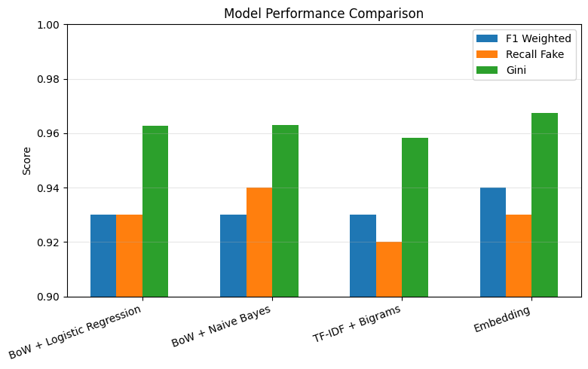
Plotting
All models perform strongly with small performance differences
Recall (Fake) highlights each model’s ability to catch misinformation
Higher complexity yields diminishing returns
Notes:
All models achieve similar overall performance, which tells us that fake news in this dataset is largely separable using surface-level language patterns.
We chose to single out Recall for the Fake class because missing fake news is more costly than occasionally flagging real news — this metric directly reflects that objective.
While the embedding model performs slightly better, the gains are marginal compared to simpler linear models, which remain competitive, interpretable, and cheaper to deploy.

Slide 10
Deliverables Timeline
 | 4-fev. | 5-fev. | 6-fev.
Preprocess | x
Split (Train, Test, Val) | x
Train our model (DT) | x
Test with other models | x
Test Embeddings | x
Predictions to file | - | x
Clean up |  | x
PPT | A, M | A, F, M, S | x
GITHUB | F,M | F, M | x
- | Did not start
x | done
A | Aleix
F | Felipe
M | Marcos
S | Sohail
Notes:
All models achieve similar overall performance, which tells us that fake news in this dataset is largely separable using surface-level language patterns.
We chose to single out Recall for the Fake class because missing fake news is more costly than occasionally flagging real news — this metric directly reflects that objective.
While the embedding model performs slightly better, the gains are marginal compared to simpler linear models, which remain competitive, interpretable, and cheaper to deploy.

Slide 11
Key Takeaways
Classical NLP models remain highly competitive for fake news detection
Feature representation matters more than model complexity
The models learn stylistic patterns, not factual truth
Challenges
Picking our best candidate models, given the very similar metrics
Notes:
This project showed us that well-engineered classical NLP pipelines can match more complex models for fake news detection, while remaining interpretable, efficient, and easier to justify.

